Slide 1


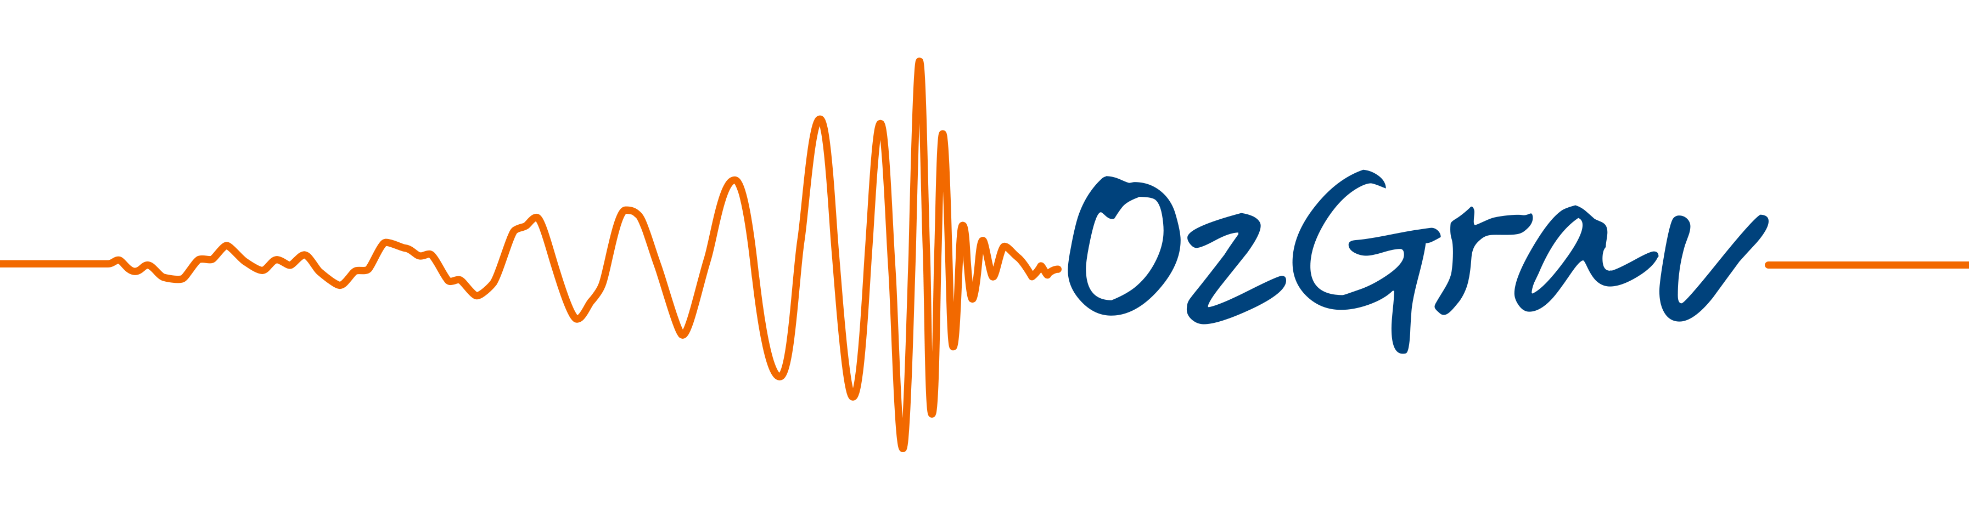
Gravitational Wave Data Analysis with Machine Learning
Jade Powell
OzGrav, Swinburne University of Technology.

Slide 2
Outline
I will give an overview of some problems in gravitational wave data analysis and how we are trying to solve them with machine learning.
I will include improving data quality, searches for binary black holes and unmodelled gravitational wave bursts, and the astrophysics of gravitational wave sources.
I do not include every study in these areas.

Slide 3
Gravitational Wave Data Quality

Slide 4
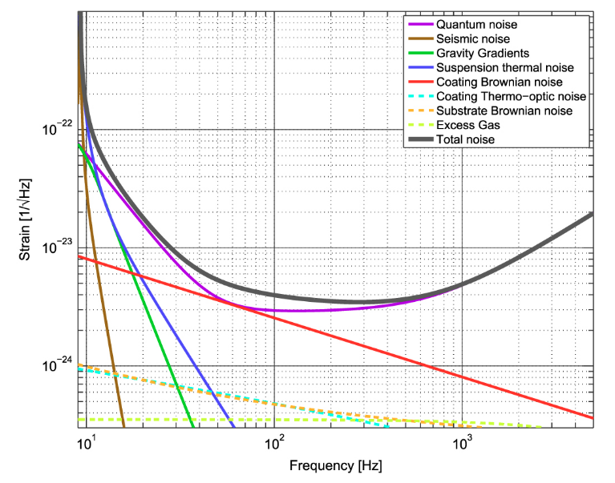
Fundamental Noise
The sensitivity of a GW detector is limited by fundamental, irreducible noise sources.
However, the sensitivity of real-world instruments is often limited by noise sources of different origins, related to instrumental and environmental disturbances.
Often these noise sources are non-stationary, i.e., their statistical properties vary over short or long time scales.
Credit: Advanced LIGO arXiv:1411.4547

Slide 5
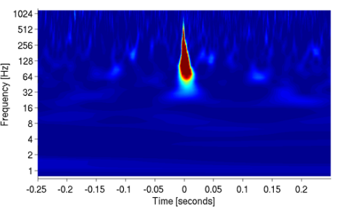
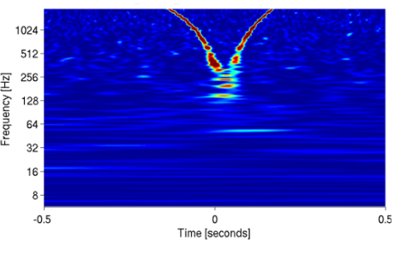
Non-Gaussian Noise
Glitches are noise transients that produce excess power in the gravitational wave channel.
They are characterized by their SNR, frequency, and morphology.
Thousands of glitches can occur everyday.
They limit the sensitivity of GW searches and can contaminate signals.

Slide 6
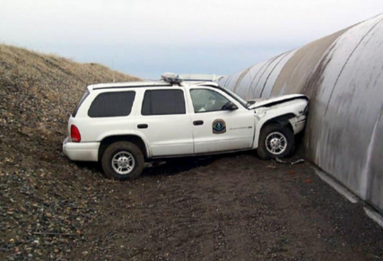
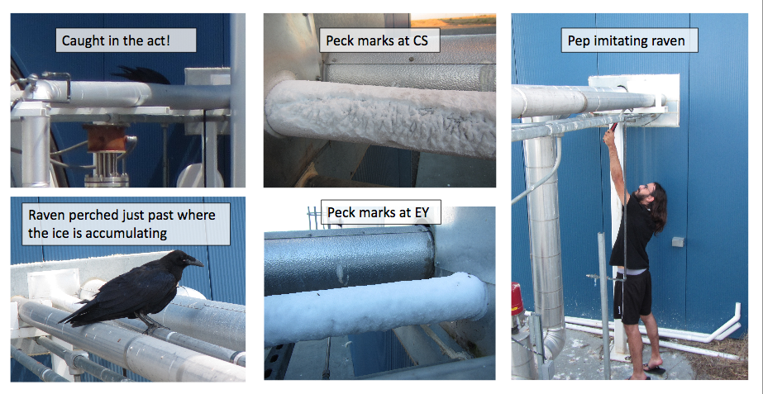
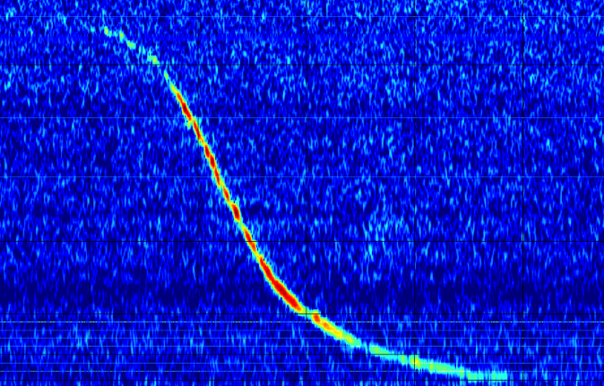
Glitches
microphone
Credit: LIGO Scientific Collaboration

Slide 7
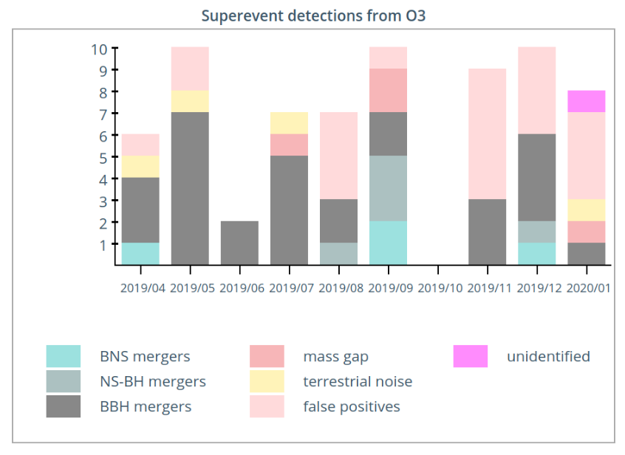
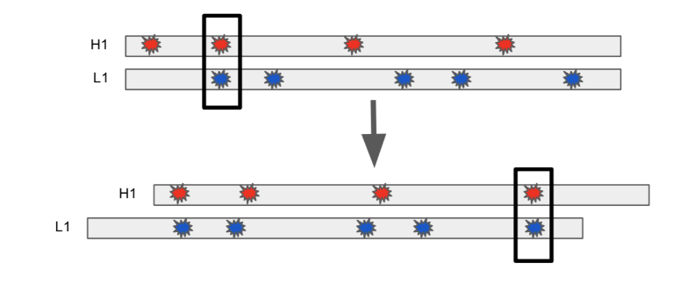
How do glitches limit search sensitivity?
Image Credit: LIGO Virgo arXiv:1710.05832
Timeslides for measuring the GW background.
Image Credit: Derek Davis
Glitches even occur during signals.

Slide 8
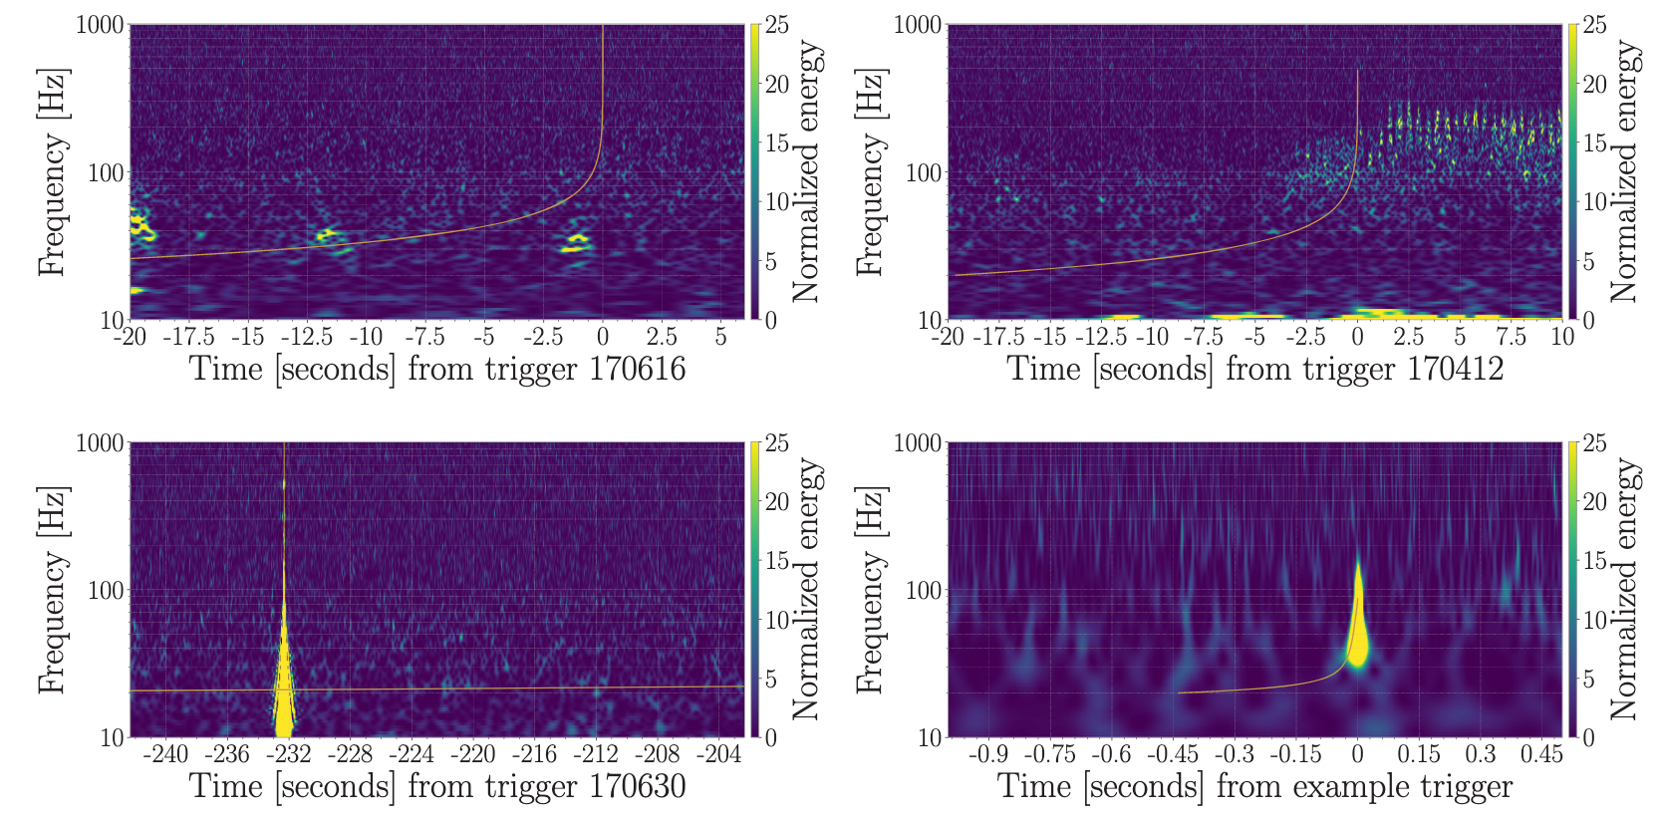
How do glitches limit search sensitivity?
Credit: LIGO and Virgo Collaborations

Slide 9
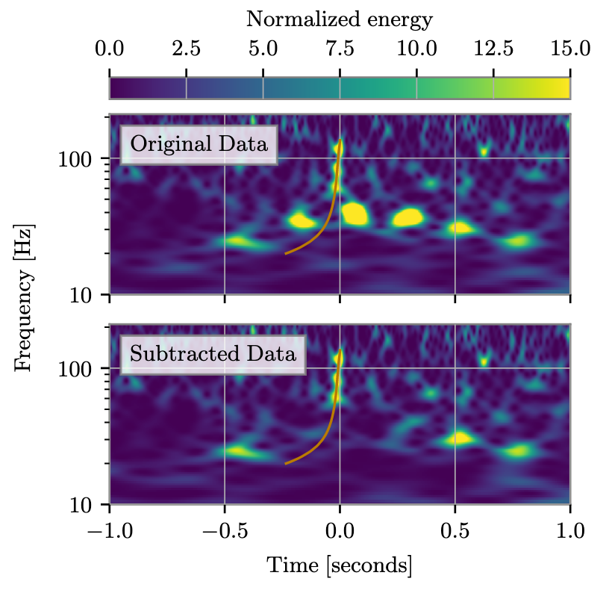
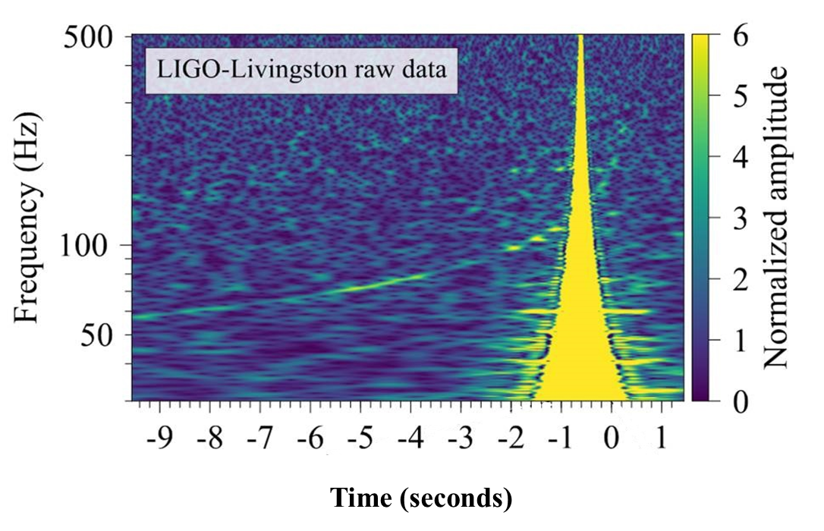
How do glitches limit search sensitivity?
Credit: LIGO and Virgo Collaborations

Slide 10
Auxiliary channels
There are over 200,000 channels which monitor instrument behaviour and environmental conditions.
These channels witness a broad spectrum of potential coupling mechanisms.
We look for correlations between data in the gravitational wave channel and these auxiliary channels to identify when glitches occur.
This can be used to “veto” a gravitational wave detection candidate.

Slide 11
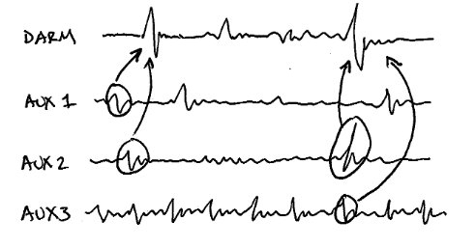
iDQ
iDQ produces low-latency probabilities of a gravitational wave candidate being a glitch.
It uses glitches in auxiliary channels to identify glitches in the GW data channel.
It provides statistical inferences about the probability that a glitch exists within the GW channel, by ingesting triggers from an trigger generator and passing to machine learning algorithms.
However, not all glitches occur in auxiliary channels.
Credit: Reed Essick

Slide 12
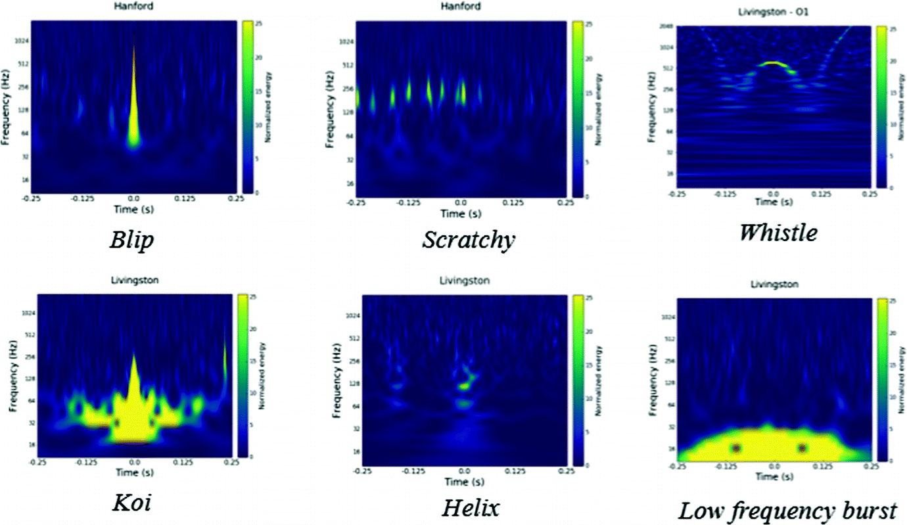
Glitch Classification
Some glitches occur only in the GW data channel.
We can try and eliminate them by classifying them into different types to help identify their origin.
Image Credit: Gravity Spy

Slide 13
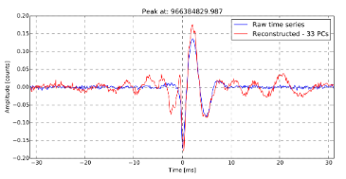
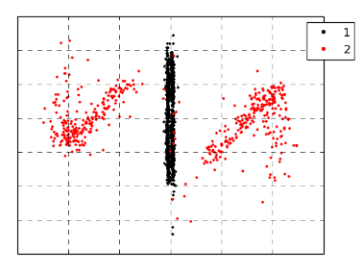
Glitch Classification with PCA
Early ML studies for glitch classification used Principal Component Analysis (PCA) and Gaussian Mixture Models (GMM).
(See Powell et al. arXiv:1609.06262 & arXiv:1505.01299)
A trigger generator finds the glitches.
The time series of whitened glitches are stored in a matrix D on which PCA is performed.
Then GMM clustering is applied to the PC coefficients.

Slide 14
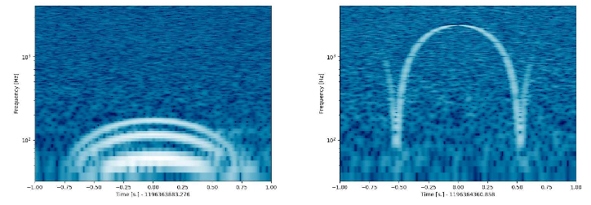
Glitch Classification with NN
These studies were then improved with the use of Neural Networks.
Razzano & Cuoco 2018 (arxiv:1803.09933) apply a CNN to simulated glitches.

Slide 15
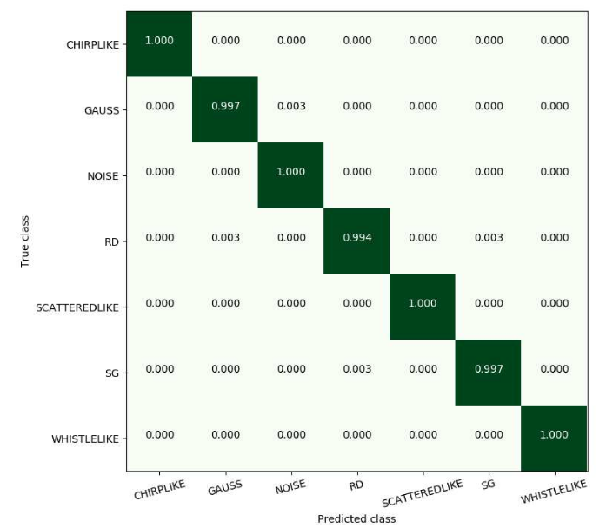
Glitch Classification with NN
They build images that cover 2 seconds around each glitch from the whitened time series.
Simulated six families of signals.
Training, validation, and test set with ratio 70:15:15.

Slide 16

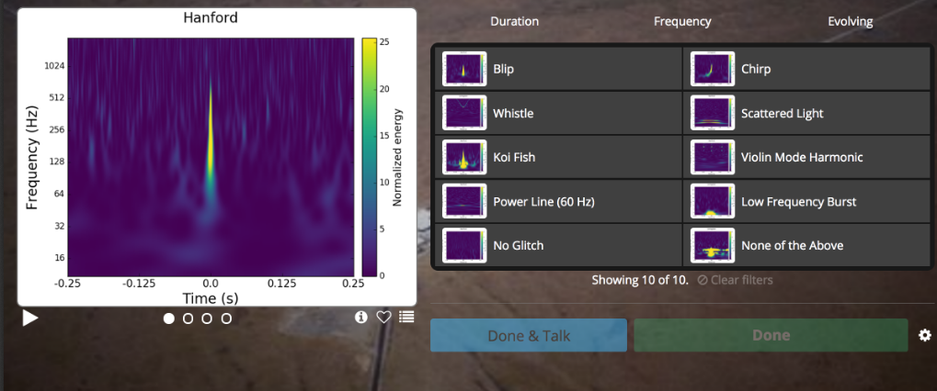
Gravity Spy
GravitySpy uses citizen scientists to produce training sets for machine learning glitch classification.

Slide 17
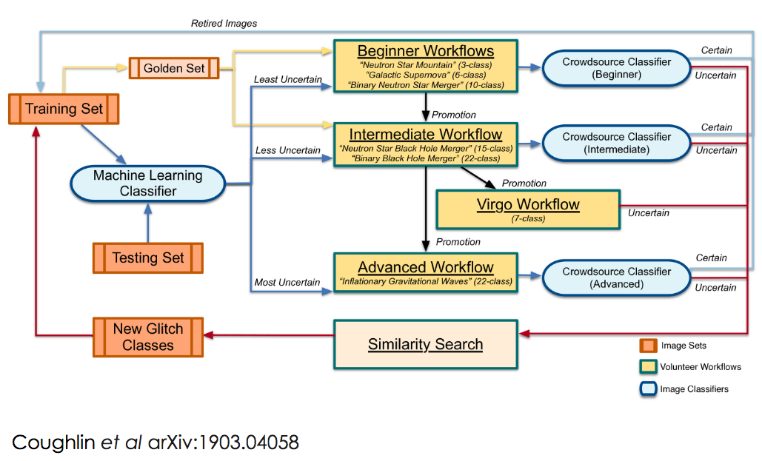
Gravity Spy

Slide 18
How do I try it myself?
Log into gravityspy.org to try classifying glitches
Download already labelled LIGO glitches for training your algorithm from zenodo
https://zenodo.org/record/1476156
https://zenodo.org/record/1476551

Slide 19
Compact Binaries Mergers (CBC)

Slide 20
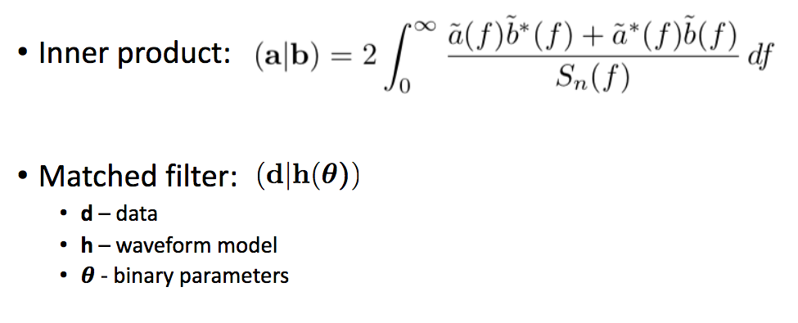
Matched filter searches
Searches for gravitational wave signals from compact binaries use matched filtering.
GW detector noise is non-Stationary and non-Gaussian.

Slide 21
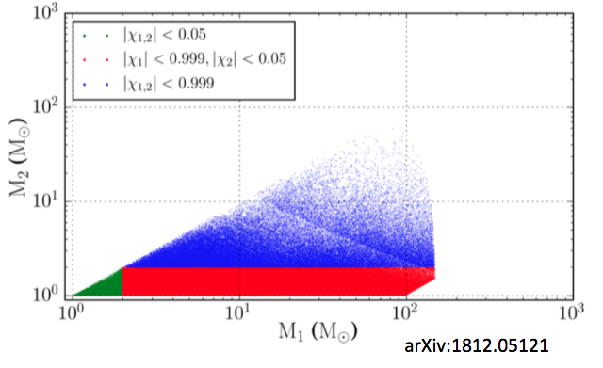
Matched filter searches
Discrete template bank is built to cover the mass-spin parameter space for potential sources.
Density of the bank is determined by the minimum overlap requirement of 0.97 so only 3% of SNR is lost.
Assume spins are aligned to the orbital angular momentum.
Do not account for tidal deformability of neutron stars.

Slide 22
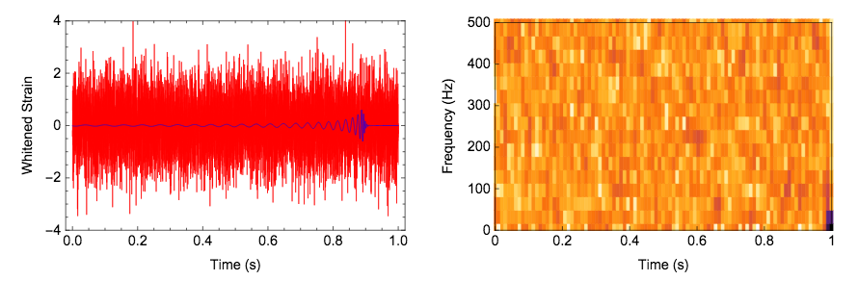
Machine learning CBC searches
George & Huerta (arXiv:1701.00008) use a system of two deep convolutional neural networks to rapidly detect CBC signals.
They use time series as input so that they can find signals too small for image recognition.

Slide 23
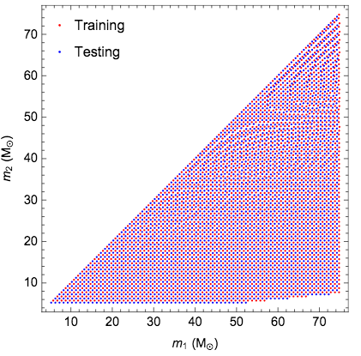
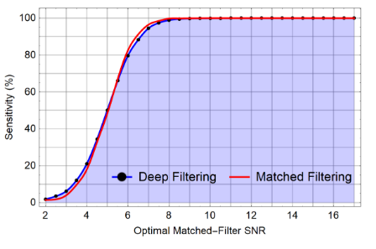
Machine learning CBC searches
George & Huerta (arXiv:1701.00008)
They find their method significantly outperforms conventional machine learning techniques, achieves similar performance compared to matched-filtering while being several orders of magnitude faster.

Slide 24
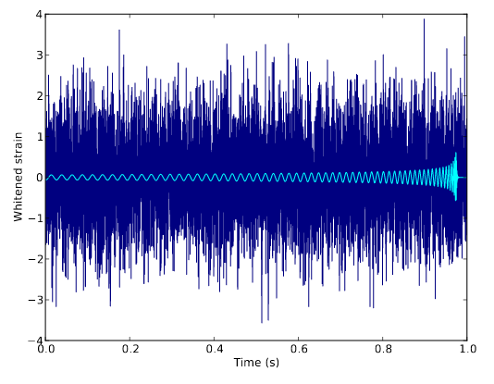
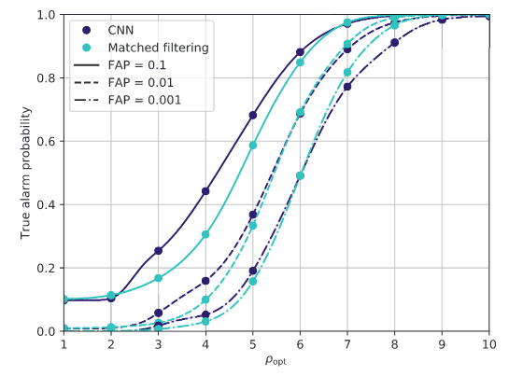
Machine learning CBC searches
Gabbard et al. (arXiv:1712.06041) also perform a CBC search with a deep convolutional neural network.
They use whitened time series of measured gravitational-wave strain as an input.
Train and test on simulated binary black hole signals in synthetic Gaussian LIGO noise.
They find they can reproduce the sensitivity of a matched filter search.

Slide 25
Low-latency source-properties (EM-bright)
LIGO & Virgo provide two probabilities in low-latency. (See arXiv:1911.00116)
The probability that there is a neutron star in the CBC system, P(HasNS)
The probability that there exists tidally disrupted matter outside the final coalesced object after the merger, P(HasRemnant).
Matched filter searches give point estimates of mass and spin but they have large errors!
To solve this a machine learning classification is used. (scikit learn K nearest neighbours, also tried random forest)

Slide 26
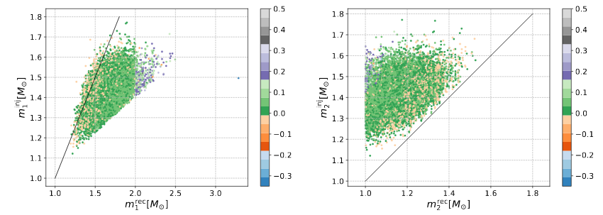
Low-latency source-properties (EM-bright)
A training set is created by injecting fake signals into gravitational wave data and performing a search.
This then produces a map between true values and matched filter search point estimates which is learnt by the classifier.

Slide 27
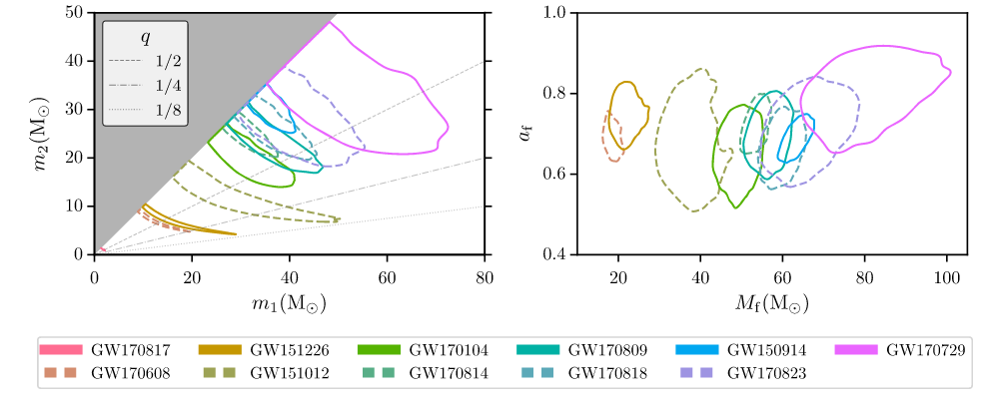
CBC Parameter Estimation
Characterized by 15 parameters. Masses, spins, distance, inclination, sky position, polarization.
Credit: LIGO & Virgo GWTC-1 arXiv:1811.12907

Slide 28
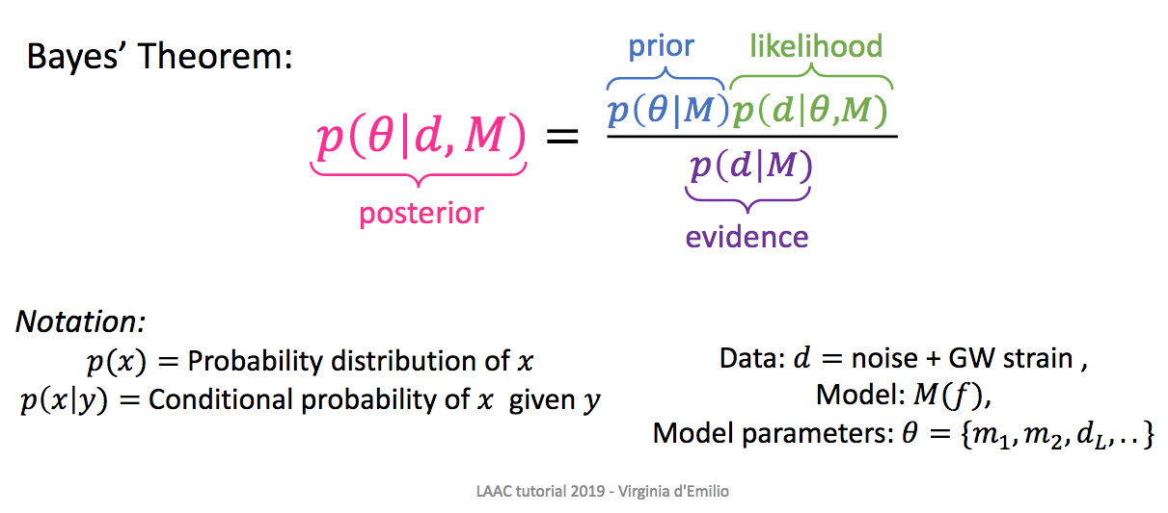
CBC Parameter Estimation

Slide 29
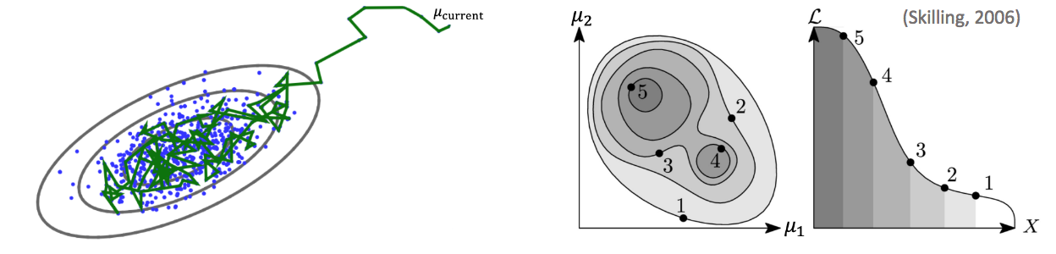
MCMC and Nested Sampling
We have two main PE codes LALInference and Bilby
MCMC Random steps are taken in parameter space, according to a proposal distribution, and accepted or rejected according to the Metropolis-Hastings algorithm.
Nested sampling can also compute evidences for model selection.

Slide 30
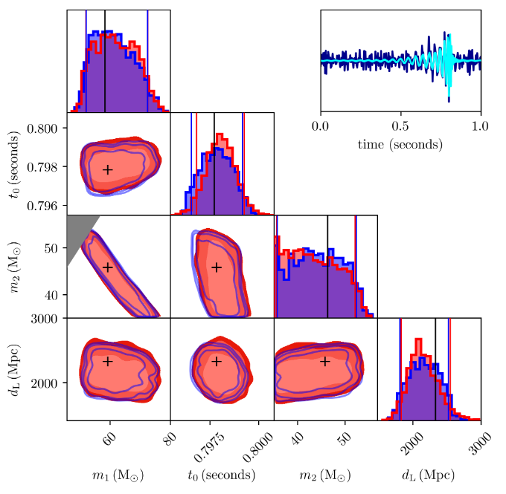
Machine Learning Parameter Estimation
Chua et al. (arXiv:1909.05966) produce Bayesian posteriors using neural networks.
Gabbard et al. (arXiv:1909.06296) use a conditional variational autoencoder pre-trained on binary black hole signals.
∼6 orders of magnitude faster than existing techniques.
Red is Gabbard et al. method and blue is Bilby nested sampling.

Slide 31
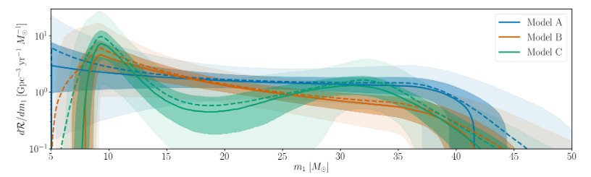
CBC Population Studies
Now that we have started to detect a population of black hole signals we can try to do population studies to try and understand signals formation mechanisms.
Population properties paper from O1+02 (arXiv:1811.12940).
Uses phenomenological models (like power laws) combined with Bayesian hierarchical modelling.

Slide 32
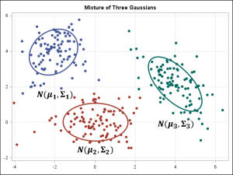
CBC Population Studies
Bayesian hierarchical modelling involves some assumptions of populations mass and spin distributions.
Does not scale well for high dimensional models and a large number of GW detections.
We can use unmodelling clustering!
Image Credit: Alison Bolen, The SAS Data Science Blog

Slide 33
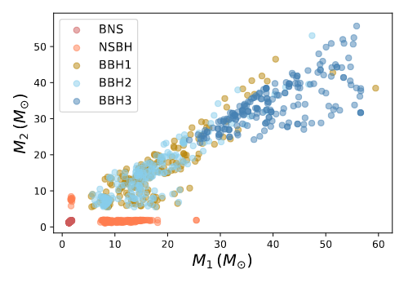
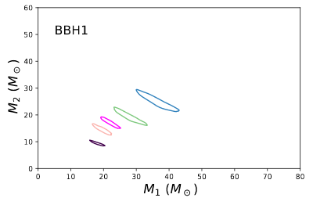
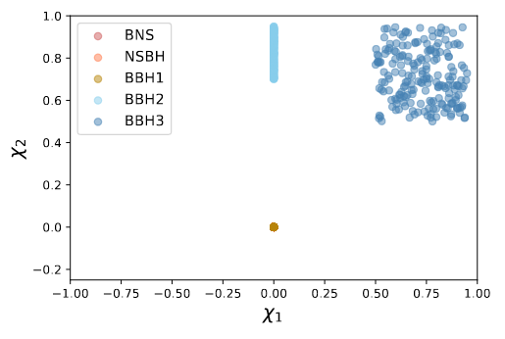
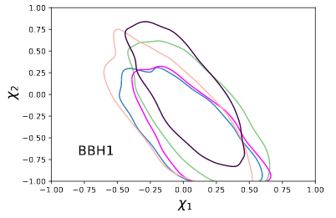
CBC Population Studies
In Powell et al. (arXiv:1905.04825) we apply unmodelled clustering to masses and spins.

Slide 34
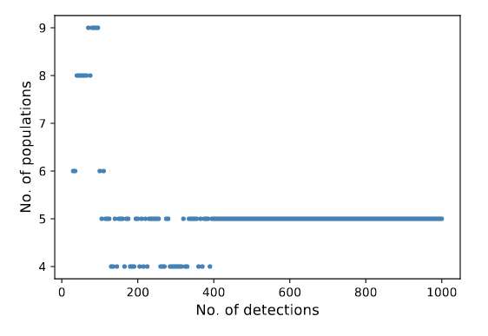
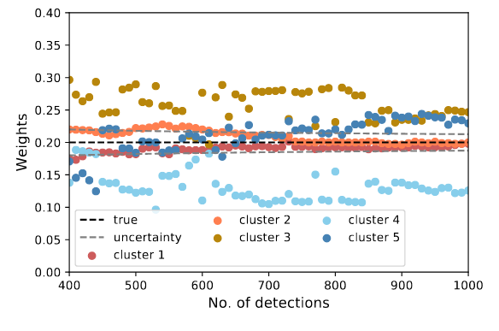
CBC population studies
Two of the populations have identical mass distributions and different spin.
This is difficult because spin is poorly measured.
Determine the number of populations and the number of CBC signals in each population.

Slide 35
Gravitational Wave Bursts

Slide 36
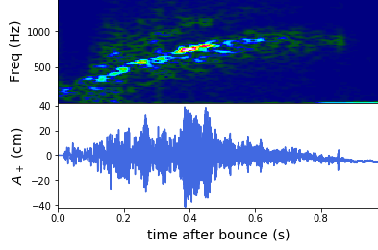
What are gravitational wave bursts?
A burst is a gravitational wave signal where the waveform morphology is partially or completely unknown.
The source could be an unknown unknown, a supernova, cosmic string, fast radio burst, compact binaries and others.
The main burst search is called coherent Wave Burst (cWB).

Slide 37
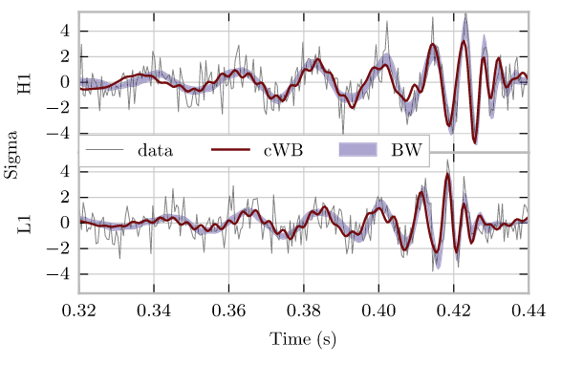
Coherent Wave Burst (cWB)
cWB searches for excess power in the time-frequency domain.
cWB produces reconstructions of gravitational wave signals.
It can detect CBC signals as well as bursts.
https://gwburst.gitlab.io/
GW150914

Slide 38
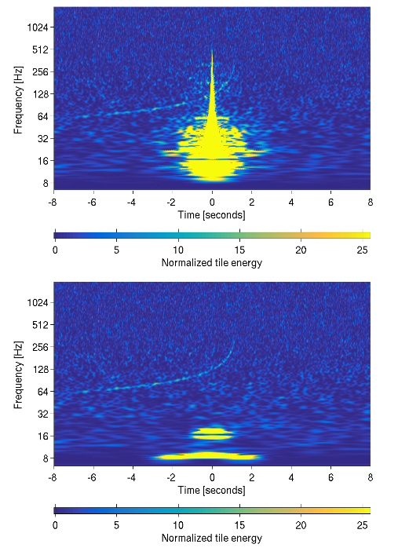
BayesWave
BayesWave is another standard burst tool. (Cornish, Littenberg, arXiv:1410.3835)
Models signals as a variable number of sine-Gaussian wavelets with power coherent across detectors.
It produces unmodelled waveform reconstructions and can remove glitches that occur during signals.
Credit: Pankow arXiv:1808.03619

Slide 39
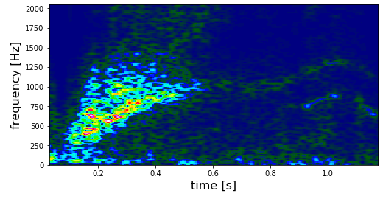
Supernova Search
Some burst searches are for targeted sources like supernovae.
There is not enough supernova waveforms to match filter search, but some supernova waveform features are known.
The known features from supernova simulations can be incorporated into supernova searches using machine learning.

Slide 40
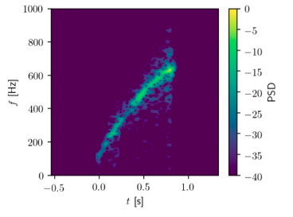
Supernova Search
Astone et al. (arXiv:1812.05363) enhance the efficiency of cWB using a neural network.
The network is trained on phenomenological waveforms that represent the g-mode emission in supernova waveforms.

Slide 41
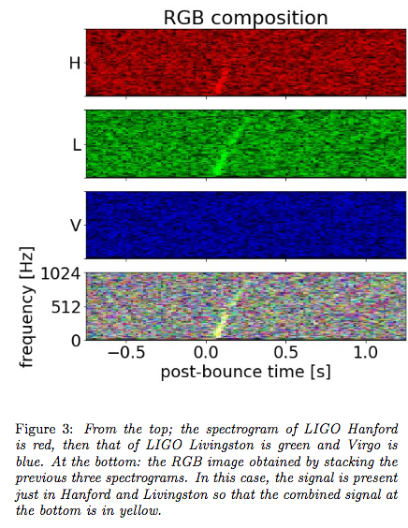
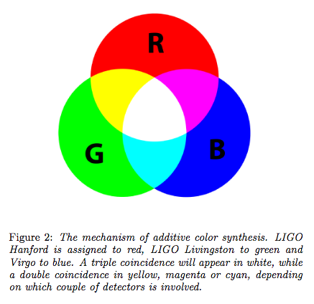
Supernova Search Astone et al.
They use colours to determine which detectors find the signal.

Slide 42
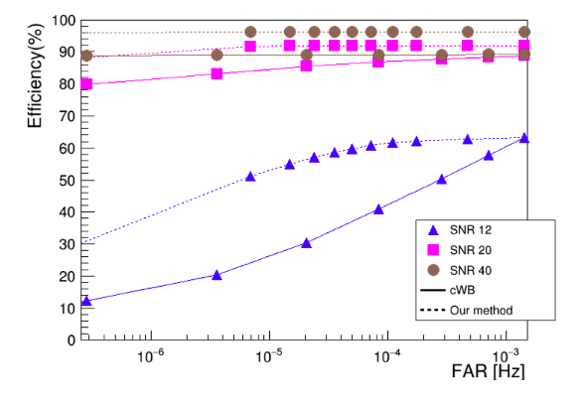
Supernova Search Astone et al.
They find their method increases the sensitivity of traditional cWB

Slide 43
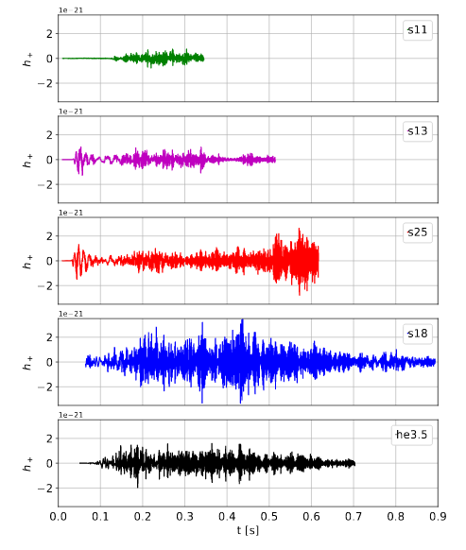
Supernova Search
Iess et al. (arXiv:2001.00279) have a different approach that does not involve cWB.
They use a trigger generator called WDF to find excess power in the detector.
Then they do a neural network classification to decide if the trigger is a signal or noise.
They train directly on supernova waveforms.

Slide 44
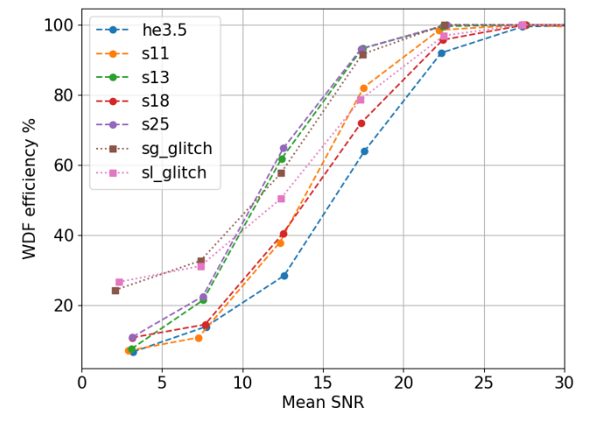

Supernova Search – Iess et al.
They use both time series and images of data.
They obtain high accuracies with both methods and include glitches.

Slide 45

Supernova Search
Chan et al. (arXiv:1912.13517) also train directly on supernova waveforms.
They use only the time series waveforms from different explosion mechanisms.

Slide 46

Single Detector Search
30% of gravitational wave data is collected when only 1 detector is in observing mode.
Can’t do time slides to measure the background if there is only 1 detector.
Cavaglia et al. (arXiv:2002:04591) use machine learning combined with cWB to perform a single detector search for supernovae.
They train a genetic programming algorithm on the output parameters of cWB.

Slide 47


Single Detector Search – Cavaglia et al.
FNR is false negative rate
Specificity is true negative rate

Slide 48
Conclusions
Machine learning can improve many areas of gravitational wave science.
Check out our gravitational wave machine learning review paper Elena Cuoco et al. arXiv:2005.03745
There is still plenty of work left to do!
You can download the data from the open science center and try it yourself.

